Slide 1


Chapter Twenty-One
Mobile Operating Systems and Connectivity

Slide 2

220-902 Objectives Covered
2.5 Identify basic features of mobile operating systems.
Android vs. iOS vs. Windows
  Open source vs. closed source/vendor specific
  App source (play store, app store, and store)
  Screen orientation (accelerometer/gyroscope)
  Screen calibration
  GPS and geotracking
  Wi-Fi calling
  Launcher/GUI
  Virtual assistant
  SDK/APK
  Emergency notification
  Mobile payment service
2.6 Install and configure basic mobile device network connectivity and email.
Wireless / cellular data network (enable/disable)
  Hotspot
  Tethering
  Airplane mode
Bluetooth
  Enable Bluetooth
  Enable pairing
  Find device for pairing
  Enter appropriate pin code
  Test connectivity
Corporate and ISP email configuration
  POP3
  IMAP
  Port and SSL settings
  Exchange, S/MIME
Integrated commercial provider email configuration
  Google/Inbox
  Yahoo
  Outlook.com
  iCloud
PRI updates/PRL updates/Baseband updates
Radio firmware
IMEI vs. IMSI
VPN

Slide 3
220-902 Objectives Covered (continued)
2.7 Summarize methods and data related to mobile device synchronization.
Types of data to synchronize
  Contacts
  Programs
  Email
  Pictures
  Music
  Videos
  Calendar
  Bookmarks
  Documents
  Location data
  Social media data
  eBooks
Synchronization methods
  Synchronize to the Cloud
  Synchronize to the Desktop
Mutual authentication for multiple services
Software requirements to install the application on the PC
Connection types to enable synchronization

Slide 4
Mobile Operating Systems
Google Android
Apple iOS
Windows Phone
Notes:
Google Android
Google is the dominant global player in the mobile market with its Android OS
Android started off as its own company and was purchased by Google in 2005
Android is Linux based. It’s primarily installed on smartphones, but
it is also found on specialized television, automobile, and wristwatch devices
The first generation was released in 2008 – see Table 21.1 for other releases
Apple IOS
Apple is the second largest player in the mobile OS market with its iOS, running on the
iPhone and iPad mobile platforms
Apple is Unix Based with the first generation of iOS being released in 2007 - see Table 21.2
The iPhone was the first popular phone to have a touchscreen that you could use with your fingers and not a stylus, and it used pinchto-zoom and intuitive finger swipes to navigate the screen
Windows Phone
The Windows Phone OS is manufactured by Microsoft, and it looks a lot like Windows 8 visually, using the same NT kernel and Metro start screen
Microsoft has a small presence in the mobile world
Microsoft started in the mobile space with Pocket PC back in 2000, mostly targeting
corporate users and their mobile devices. In 2003, it changed the name to Windows Mobile, still targeting the same users

Slide 5
Source Code Classification
Open source
Closed source/vendor specific
Notes:
Source code is the programming code used in the creation of software
Proprietary software—also known as closed-source and vendor-specific
software—is licensed to others for use but is kept within the control of the original publisher.
Open-source software, on the other hand, is licensed to the developer community
to be further developed, shared, and sometimes marketed, depending on the language of the licensing agreement. No money involved

Slide 6
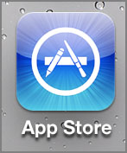
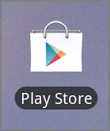
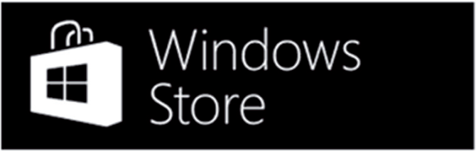
Application Sources
Apple App Store
Google Play (fmr Android Market)
Windows Store
Notes:
Apple’s App Store opened for business in 2008 just ahead of the introduction of the iPhone 3G
Apple requires annual fees from developers while Android requires only a one-time
Fee – Ex 21.1 Downloading an App from App store
A few months after the Apple App Store opened in 2008, Google’s Android Market was
launched and made available to users. In 2012, the Market and the Google Music service
were combined to form Google Play, which took the place of both component services.
Google does not guard apps for Android as closely as Apple guards its apps. In fact, you
can use third-party utilities to find and download Android apps - Ex 21.2

Slide 7
Sensors and Calibration
Tap
Swipe
Pinch
Kinetics
Notes:
Mobile devices are built around a concept called gesture-based interaction, whereby
users use their fingers and various movements to interact with their touchscreen
The three gestures that most mobile OSs understand are tap, swipe, and pinch, and the sensors are part of a closely related concept called kinetics:
Tap - like clicking on a Mac or double-clicking on a PC – Tap of the finger acts like a mouse pointer
Swipe – like turning the page of a book. Users will use this to move pages or scroll up or down
Pinch By placing two fingers apart and then pinching them together (while touching the screen, of course), users can zoom out
Kinetics refers to the sense of motion. iPhone 6 has a gyroscope, accelerometer, linear acceleration sensor, magnetometer, altitude sensor, and gravity sensor. The phone can act like a GPS and compass, and they also detect movements such as tilting or shaking the device that many apps take advantage of. Most Android-based devices will have a similarly impressive list of sensors.

Slide 8
Screen Orientation
Accelerometer
  Forward/backward, left/right, up/down
Gyroscope
  Roll, pitch, yaw
Notes:
Accelerometer
An accelerometer measures the acceleration
Very first kinetic sensor – only on in original iPhone until iPhone 4
The three axes (x, y, and z) of movement make up the totality of an accelerometer’s capabilities.
Gyroscope
A gyroscope is a sensor that detects rotation around any of three axes, known as roll, pitch, and yaw. These three new axes of movement complement those detected by the accelerometer, producing a high level of accuracy when detecting the device’s orientation
Roll – flipping the phone lying on it’s back from left to face down to face up again
Pitch – flipping the phone lying on it’s back from top or bottom
Yaw – Phone on it’s back rotated clockwise or counterclockwise

Slide 9
Positioning and Geolocation
Magnetometer
  Compass heading
Global positioning system (GPS)
  Absolute position on earth
Geotracking and geotagging
Notes:
Geolocation, is the relative and absolute positioning of your device from the viewpoint of the planet and space
2 Technologies allow smartphones to accomplish this: Magnetometer and GPS
Magnetometer
To detect the position of a device relative to a landmark on the planet, we use a compass. A magnetometer allows a device to sense magnetic fields, such as the one our planet exhibits at the magnetic north pole
Global Positioning System
To detect the absolute position of a device with respect to the manmade latitude and longitude markings on the surface of the earth, triangulation is required. Using three satellites at a fixed distance above the earth’s surface, devices with global positioning system (GPS) capability can determine their own absolute position
Geotracking and Geotagging
Geolocation information collected by your mobile device can be used in various ways,
some welcome and some less so. E.g. Apple’s tracking log scandal of 2010
Geotagging uses similar information to add location information to various forms of
media, such as photographs taken with the device and messages sent with the device.

Slide 10
Screen Calibration
Resistive touchscreens
  Required by the technology
Capacitive touchscreens
  Not normally required
Combination touchscreens
  Prolonged resistive use leads to a need for recalibration.
Notes:
Resistive Touchscreens
Resistive screens require recalibration
This is because they have an almost unperceivably flexible outer surface that eventually wears and changes over time due to repeated flexion
They are built using two layers of sturdy panels separated by an air pocket. One
panel is flexible, usually made of plastic, and the other panel is often rigid, usually made
of glass. Both panels are coated with indium tin oxide (ITO), which is conductive
Capacitive Touchscreens
Don’t require recalibration
Combined Touchscreens
Many manufacturers migrated to a smoother surface and a stylus with a softer tip.
With such a surface, some manufacturers created touchscreens that were both resistive and capacitive. If you used the stylus or your fingernail to press down on the screen, the resistive nature reacted. If you instead glided your fingertip or special capacitive stylus across the surface, the capacitive features of the display took over

Slide 11
Additional Mobile OS Features
Launcher/GUI
Virtual assistant
Emergency notification
Wi-Fi calling
Mobile payment service
Notes:
Launcher/ GUI
The area of the screen with icons is known as the launcher – i.e. the area of the device from which applications are launched The launcher sets the look and feel of the OS
Google - Customized launchers are sometimes referred to as home screen replacements
Smart launchers, which will adapt and try to put the most relevant information in front of you. For example, it might give you the weather report or your daily schedule when you wake up in the morning
Virtual Assistant
Siri (Apple) and Google Now, Cortana (Windows 10) are examples of a virtual assistant, also called a personal assistant.
You ask a question, and the phone uses its search feature to find an answer
Emergency Notification
Your mobile OS can provide alerts in the event of emergency situations. This is called
emergency notification. By default, iOS has two types of notifications it can provide:
AMBER alerts (child missing) and Emergency alerts (hurricane, etc. issued by Govt agency)
Alerts are regional
Wi-Fi Calling
The idea is similar to Voice over IP (VoIP) but it’s wireless. When it’s functioning properly, users won’t even notice that the call has been switched from the cell network to the Wi-Fi network because such transitions should be seamless. Useful in areas with WIFI but no data
Mobile Payment service
The technology used to support financial transactions using a mobile device is called
mobile payment service. Unlike many technologies that get a foothold in developed firstworld countries, mobile payment services have gained the biggest traction in developing markets, where banks are scarce and their infrastructure is somewhat unreliable

Slide 12
Mobile Payment Methods
Text Message Service/Products
Direct Mobile Billing
Mobile Web payment
Near field communication
Notes:
There are a few different ways that mobile payment services are implemented:
Text messages for services/products With this method, the user sends an SMS or MMS text message to the merchant, often including a short code. The merchant receives the message, and a charge is applied to the user’s phone bill or other online wallet.
Direct mobile billing When shopping online, the consumer may choose to have their
mobile account charged directly; the charge is directly applied to their phone bill.
Mobile web payments As opposed to direct mobile billing, users of this method need to download an app that processes payments for them. In addition, it typically requires the user to process the payment through a bank, credit card, or online payment service.
Online wallets through companies such as PayPal, Amazon Payments, and Google Wallet
are examples of apps that allow users to make mobile web payments.
Near field communication Using near field communication (NFC), a user will simply
move their device within range (about 4" or 10cm) of the merchant’s receiver, and the payment will be processed.

Slide 13
Network Connectivity
Wi-Fi
Bluetooth
Cellular connections
  Mobile hotspots and tethering
Airplane mode
Notes:
A mobile hotspot lets you share your cellular Internet connection with Wi-Fi capable devices
Tethering is when you have connected a device to a mobile hotspot
There are three downsides to using your mobile phone as a hotspot.
Speed
Cost
Security
4G Verizon devices functioning as mobile hotspots can support up to 10 concurrent
connections. 3G devices can support only five

Slide 14
Cellular Updates
Baseband OS
PRI updates
PRL updates
Acronyms to know:
  IMEI
  MEID
  ICCID
  SEID
Notes:
Most mobile phones actually have three Operating Systems.
Duties are split up between the operating systems, simply because there are so many specialized tasks for the phone to perform
The main OS and 2 Oss -These two OSs are very small, typically only a few hundred kilobytes in size, and they are referred to as real-time operating systems (RTOSs
First, there is a baseband OS that manages all wireless communication, which is actually handled by a separate processor. Baseband update, simply means an update of the baseband OS
Second, a subscriber identity module (SIM) OS manages all data transfers between the phone and the SIM chip, which is a small memory chip that stores user account information, phone identification, and security data, and it is generally tied to a specific carrier.
Two other updates of which you should be aware are PRI updates and PRL updates.
Product Release Instruction (PRI) contains settings for configuration items on the device that are specific to the network that it’s on.
The Preferred Roaming List (PRL) is the reference guide the phone uses to connect to the proper cell phone tower when roaming.
International Mobile Equipment Identity (IMEI) This is a 15-digit serial number that is unique to each phone.
Mobile Equipment Identifier (MEID) This is an alternate form of a serial number. It’s identical to the first 14 numbers of the IMEI. Sprint and Verizon were the first to use MEIDs
International Mobile Subscriber Identity (IMSI) This is a unique 15-digit identifier that describes a specific mobile user and their network
Integrated Circuit Card Identifier (ICCID) This is a 19- or 20-digit identifier for each SIM chip globally. It’s like a serial number for the SIM card.
Secure Element Identifier (SEID) This is a very long hexadecimal code that uniquely identifies the phone, and it is used in security applications, NFC, and features like Apple Pay

Slide 15
Wi-Fi Connectivity
Connect as you would any other computer
Settings in iPhone and Android
In some cases, can disable cellular use for data

Slide 16
Bluetooth Connectivity
Pairing between Bluetooth devices usually works.
Data communications only work when service is included.
Can pair for audio over many modern sound systems and vehicles.
Notes:
1. Turn on the Bluetooth hands-free device.
a. Enable Bluetooth.
b. Enable pairing.
2. Use your mobile device to locate and select the Bluetooth device.
3. Enter the Bluetooth device’s passcode.
4. Confirm pairing on the Bluetooth device by pressing a button or a combination of buttons.
5. Test the connectivity.

Slide 17
Automatic Email Configuration
Easier today than originally
Enter address and password.
  Common services may work.
  Custom domain accounts may not.
Notes:
When configuring mobile devices to access email, you will be attaching to one of two
types of services.
The first is an integrated commercial provider, which includes Google (Gmail), Yahoo!, Outlook.com, and iCloud email. (nearly automatic)
The second is a corporate or ISP-based email service.
Ex 21.11, 21.12

Slide 18
Manual Email Configuration
Sending email
  SMTP: TCP port 25
Retrieving email
  POP3: TCP port 110
  IMAP4: TCP port 143
Notes:
You must always use SMTP for sending mail. You must decide between the
Use of POP and IMAP for interacting with the mail server to retrieve your mail with the Client.
IMAP is a clear choice because of its extensive interaction with the server, allowing the client to change the state or location of a mail item on the server without the need to download and delete it from the server
POP limits client interaction with the server to downloading and deleting items from the server, not allowing their state to be changed by the client

Slide 19
Secure Mail Ports
SMTP with SSL: TCP port 465
SMTP with TLS: TCP port 587
IMAP4 with SSL/TLS: TCP port 993
POP3 with SSL/TLS: TCP port 995
Notes:
The common ports previously discussed are not secure
Internet mail services require secure connections using Secure Sockets Layer (SSL) or Transport Layer Security (TLS)
When you’re establishing a manual email client connection, these are the ones that you are most likely to require
You will need to know the server names for your service

Slide 20
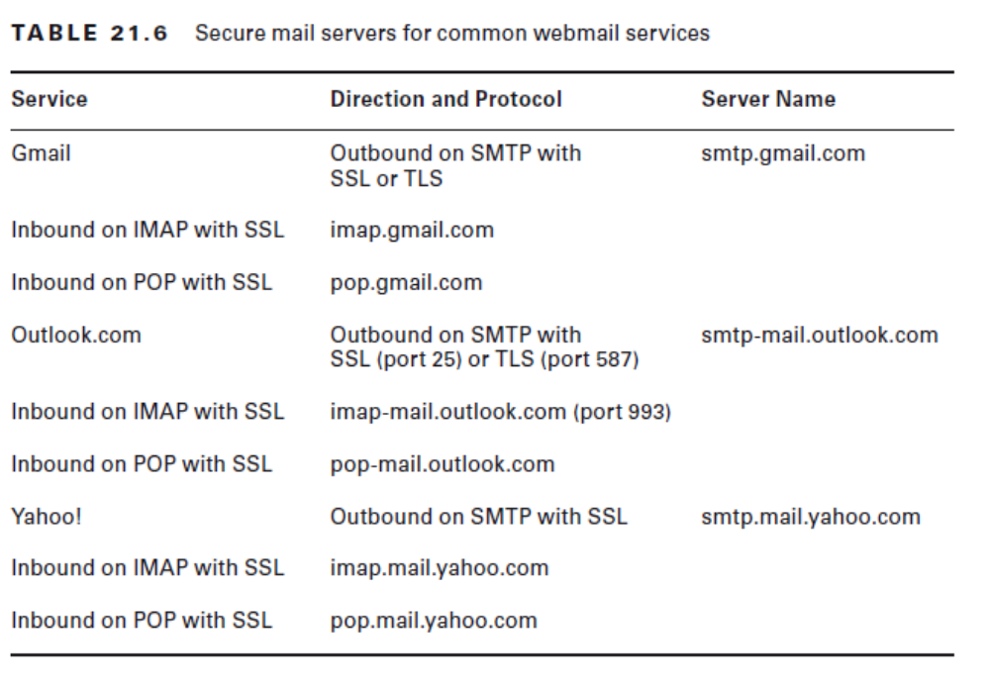

Slide 21
Exchange and S/MIME
Exchange is Microsoft’s email server.
Supported by mobile OSs
Enter username and password to attempt automatic configuration.
Manual configuration if automatic fails
  Likely will only ask for server name
S/MIME is encryption
Notes:
S/MIME (Secure/Multipurpose Internet Mail Extensions) is a standard for public key encryption and signing of MIME data
Android and iOS both support it
Ex 21.13 – enabling S/MIME

Slide 22
Mobile Device Synchronization
Contacts
Calendar
Email
Photos
Music
Videos
Apps
Bookmarks
Documents
Location data
Social media data
eBooks
Notes:
Synchronization is the act of mirroring all unique changes and additions from one device
to the other.
Common connections include over USB or FireWire, across Wi-Fi, and over a Bluetooth connection. Some connections allow synchronization; others do not
The above list constitutes the most common types of data to be synchronized by all utilities such as iTunes

Slide 23
Syncing Mobile Devices
iOS
  iTunes
  iCloud
Android
  Different manufacturers use different methods.
  Often cloud-based
Notes:
To sync a device with a desktop, iTunes must be installed on a compatible non-iOS computer (default in MAC OS)
iCloud
When a user creates an Apple ID, it’s used to log into the iTunes store, but it can also be used for an iCloud account. Apple recommends that the same username be used for both, but it is not required
Open the Settings app, and choose iCloud.

Slide 24
iTunes Installation Requirements
Windows (1GHz Intel or AMD processor and 512MB of RAM)
Mac OS X (Mac computer with an Intel processor and 512MB of RAM)
Notes:
Page 1089
Windows
To play 720p HD video, an iTunes LP, or iTunes Extras
2.0GHz Intel Core 2 Duo processor
1GB of RAM
Intel GMA X3000, ATI Radeon X1300, or NVIDIA GeForce 6150 video card
To play 1080p HD video
2.4GHz Intel Core 2 Duo processor
2GB of RAM
Intel GMA X4500HD; ATI Radeon HD 2400; NVIDIA GeForce 8300 GS video card
Screen resolution of 1024×768 or greater; 1280×800 or greater to play an iTunes LP (interactive album artwork) or iTunes Extras (multimedia elements alongside music)
16-bit sound card and speakers
Broadband Internet connection
iTunes-compatible CD or DVD recorder (optional)
MAC
To play 720p HD video, an iTunes LP, or iTunes Extras
2.0GHz Intel Core 2 Duo processor
1GB of RAM
To play 1080p HD video
2.4GHz Intel Core 2 Duo processor
2GB of RAM
Screen resolution of 1024×768 or greater; 1280×800 or greater to play an iTunes LP or iTunes Extras
Broadband Internet connection
Apple combo drive or SuperDrive (optional)
The Macintosh software requirements are shown in the following list:
Mac OS X version 10.7.5; Apple Music requires OS X version 10.9.5.
400MB of available disk space.
iTunes Extras requires OS X 10.10.3

